Slide 1
VW Settlement Forum
Missouri Clean Cities Stakeholder Forum
May 4, 2017

Slide 2
Department of Energy Clean Cities program
The U.S. Department of Energy's (DOE’s) Clean Cities program advances the nation's economic, environmental, and energy security by supporting local actions to cut petroleum use in transportation. Since it’s inception in 1993 we have displaced more than 8.5 billion gallons of petroleum.
Our Mission
Clean Cities advances the energy, economic, and environmental security of the United States by supporting local actions to cut petroleum use in transportation.

Slide 3
St. Louis Clean Cities
St. Louis Clean Cities is a stand alone non profit
that was designated in 1994.
Our area covers Eastern Missouri and Southern Illinois.
I personally have been involved with Clean Cities since it’s inception in 1993.
My background consists of 40 years in the automotive/diesel field as a technician
18 years as a Fleet Director. Served in the US Air Force and Missouri National
Guard. Last 6 years as the Director of St. Louis Clean Cities.
Kevin Herdler
Executive Director
314-397-53908
clnfuel@gmail.com
www.stlcleancities.org

Slide 4
Kansas City Region and Central Kansas Clean Cities
Kansas City Regional Clean Cities
Established in 1998 Housed at Metropolitan Energy Center Staff Kelly Gilbert (kelly@metroenergy.org) David Albrecht (david@metroenergy.org) Funding U.S. Department of Energy U.S. Environmental Protection Agency Various other contracts Dues from stakeholders
Central Kansas Clean Cities
Established in 2013 Housed at Metropolitan Energy Center Staff Kelly Gilbert (kelly@metroenergy.org) Shawn Schmidt (shawn@metroenergy.org) Funding Kansas Soybean Commission Dues from stakeholders

Slide 5
Funding Breakdown
U.S. EPA complaint against Volkswagen, AG regarding Clean Air Act violations in approximately 580,000 model year 2009 to 2016 motor vehicles containing 2.0 and 3.0 liter diesel engines.
Last December, Volkswagen agreed to spend up to $14.7 billion to settle allegations of cheating emissions for the 2L engines. Settlement funds will be used to reduce NOx emissions with three projects:

Slide 6
ZEV Investment: The National Plan
The Volkswagen Group of America created Electrify America LLC, a wholly-owned subsidiary, to fulfill its Appendix C commitments.
The investment: $1.2 billion to be spent in $300 million increments over four 30-month cycles. The report “National ZEV Investment Plan” at www.electrifyamerica.com describes the $300 million in investments that will be made in the first 30-month cycle.
Cycle 1 Cycle 2 Cycle 3 Cycle 4
(Q1 2017 – Q2 2019) (Q3 2019 - Q4 2021) (Q1 2022 – Q2 2024) (Q3 2024 – Q4 2026) $300M $300M $300M $300M

Slide 7
ZEV Investment: Infrastructure
A network of 2,500+ non-proprietary electric vehicle chargers at more than 450 station sites.
~240 charging station sites will be installed or under development outside of California by the end of the first cycle.
Along high-traffic corridors between metropolitan areas, including multiple cross country routes
4-10 150 kW and 320 kW DCFC at each location along EV travel corridors.
39 U.S. states, built along corridors with a high correlation with the EV Charging Corridors recently designated by the Federal government.
~ 66 miles apart, with no more than 120 miles between stations, meaning many shorter range ZEVs available today will be able to use this network.
300+ community-based charging station sites
Installed in workplaces, retail, multifamily residential locations and municipal lots and garages
11 target metropolitan areas: Boston, Chicago, Denver, Houston, Miami, New York City, Philadelphia, Portland, Raleigh, Seattle and Washington, D.C.
Chargers at these locations will include a mix of Level 2 and/or DC Fast Chargers from 50 to 150+ kW.

Slide 8
ZEV Investment: Impact
The most advanced charging technology ever deployed. 320 kW charging has the capability to add about 19 miles of range per minute to a vehicle, allowing 200-300 miles of fuel to be added in only 15-20 minutes for some next generation vehicles.
The ZEV infrastructure is compatible with many ZEV brands.
multiple technologies (Level 2 and DC fast charging),
non-proprietary connectors,
and multiple fast-charging protocols
An educational campaign will impart the benefits of ZEVs and address consumer barriers to adoption.
For more information: www.electrifyamerica.com

Slide 9
Environmental Mitigation Trust
$2.7 billion will be placed in an Environmental Mitigation Trust, and will be allocated to beneficiaries (states, tribes, and certain territories) based on the number of impacted VW vehicles in their jurisdictions
The Trust will support projects that reduce NOx emissions where the VW vehicles were, are, or will be operated.
To become a beneficiary, each eligible beneficiary must file a single Certification Form no later than 60 days after the Trust Effective Date
Each form must include a designation of Lead Agency, certified by the Office of the Governor, indicating which agency, department, office or division will have the delegated authority to act on behalf of each state
Missouri allocation: $39,084,815

Slide 10
“Second Partial Consent Decree” for 3.0 Liter Subject Vehicles
Department of Justice web page (U.S. District Court)
http://www.cand.uscourts.gov/vwmdl/proposed-settlement-3-liter
Proposed activity is to add a proportionate share of the total value of the mitigation action ($225,000,000) to each state’s Environmental Mitigation Trust.
Missouri (3.0L) $2,067,236
MO potential total $41,152,051

Slide 11
Environmental Mitigation Trust: Beneficiary Mitigation Plan
After being designated a beneficiary, states must submit a high-level Beneficiary Mitigation Plan that summarizes how the funds will be spent. Plans should address:
Overall goal for the use of the funds;
Categories of anticipated eligible mitigation actions, and preliminary assessment of the percentages of funds anticipated to be used for each type of action;
How the proposed actions will impact air quality in areas that bear a disproportionate share of the air pollution burden within its jurisdiction;
Expected ranged of emissions benefits.
Beneficiaries may adjust their goals and spending plans at their discretion and will provide the Trustee with updates to their Beneficiary Mitigation Plan
Beneficiaries may use their Final Approved DERA Workplan if they intend to use the DERA option

Slide 12
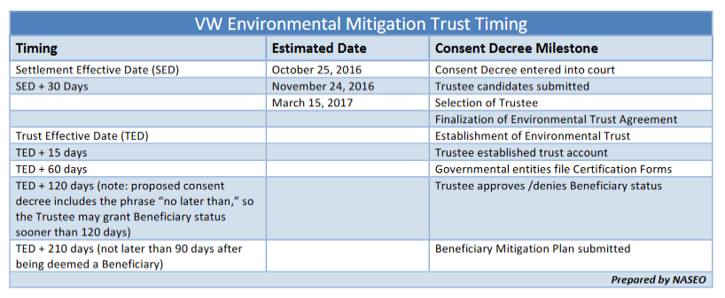
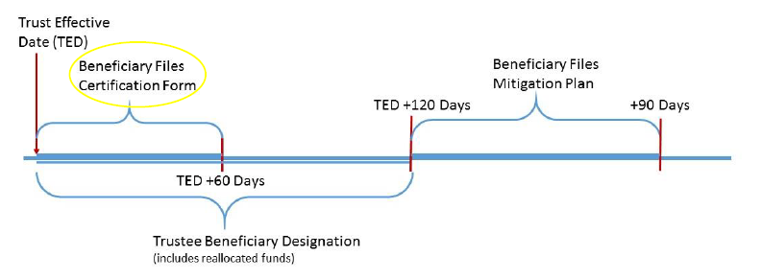
Environmental Mitigation Trust: Timeline
No clear way to know how long it will take to negotiate and finalize the Trust Agreement with the selected Trustee

Slide 13
Environmental Mitigation Trust: Eligible Mitigation Actions
Eligible Large Trucks
1992-2009 model year Class 8 Local Freight or Drayage
Eligible Large Trucks must be scrapped, and may be Repowered or replaced with any new diesel, alternative fueled, or all-electric engine
Eligible Buses
2009 model year or older Class 4-8 school buses, shuttle buses, or transit buses
Including buses under contract to
Eligible buses must be scrapped, and may be Repowered or replaced with any new diesel, alternative fueled, or all-electric engine
Eligible Medium Trucks
1992-2009 model year Class 4-7 Local Freight Trucks
Eligible medium trucks must be scrapped, and may be Repowered or replaced with any new diesel, alternative fueled, or all-electric engine
…and Eligible Freight Switchers
Pre-Tier 4 switcher locomotives that operate 1000 or more hours per year
Eligible Freight Switchers must be scrapped, and may be Repowered or replaced with any new diesel, alternative fueled, or all-electric engine or Freight Switcher that is certified to meet applicable EPA emissions standards
Trucks & Buses

Slide 14
Environmental Mitigation Trust: Eligible Mitigation Actions
Trucks and Buses (and Freight Switchers) | Percentage of Project That Can Be Funded Through Trust
 | Government-Owned Eligible Trucks and Buses, or Buses Under Contract with Public School District | Non-Government Owned Eligible Trucks and Buses
Repower with new diesel or AFV engine | Up to 100% | Up to 40%
Purchase new diesel or AFV vehicle | Up to 100% | Up to 25% (50% for drayage trucks)
Repower with all-electric engine, including infrastructure | Up to 100% | Up to 75%
Purchase new all-electric vehicle, including infrastructure | Up to 100% | Up to 75%

Slide 15
Environmental Mitigation Trust: Eligible Mitigation Actions
Airport Ground Support and Forklifts | Percentage of Project That Can Be Funded Through Trust
 | Government Owned Eligible Airport Ground Support Equipment | Non-Government Owned Eligible Airport Ground Support Equipment
Repower with all-electric engine, including infrastructure | 100% | 75%
Purchase new all-electric equipment, including infrastructure | 100% | 75%
Eligible Airport Ground Support Equipment
Tier 0, Tier 1, or Tier 2 diesel powered airport ground support equipment, and uncertified or certified to 3 g/bhp-hr or higher emissions, spark ignition engine powered airport ground support equipment
Eligible airport ground support equipment must be scrapped, and may be Repowered with an all-electric engine, or replaced with the same equipment in an all-electric form
Eligible Forklifts
Forklifts with greater than 8,000 pounds lift capacity
Eligible forklifts must be scrapped, and may be Repowered with an all-electric engine, or replaced with the same equipment in all-electric

Slide 16
Environmental Mitigation Trust: Eligible Mitigation Actions
EVSE | Percentage of Project That Can Be Funded Through Trust
EVSE - publicly available at government owned property | 100%
EVSE - publicly available at non-government owned property | 80%
EVSE - at workplace but not available to general public | 60%
EVSE - at multi-unit dwelling but not available to general public | 60%
FCVSE - publicly available and able to dispense at least 250kg/day | 33%
FCVSE - publicly available and able to dispense at least 100kg/day | 25%
Light Duty Zero Emission Vehicle Supply Equipment
May use of to 15% of its allocation of Trust Funds on the costs to acquire, install, operate and maintain new light duty ZEV supply equipment. Eligible projects include:
Level 1, Level 2 or DC fast chargers located in a public place, workplace, or multi-unit dwelling
Hydrogen fuel cell supply equipment, including hydrogen dispensing equipment that is located in a public place

Slide 17
Environmental Mitigation Trust: Eligible Mitigation Actions
Eligible Ferries/Tugs
Unregulated, Tier 1 or Tier 2 marine engines
Eligible ferries and tugs must be scrapped, and may be Repowered with any new Tier 3 or Tier 4 diesel, alternative fueled, or all-electric engines or may be upgraded with an EPA Certified Remanufacture System or an EPA Verified Engine Upgrade
 | Percentage of Project That Can Be Funded Through Trust
 | Government-Owned Ferries and Tugs | Non-Government Owned Ferries and Tugs
Repower with new diesel, AFV engine | 100% | 40%
Repower with all-electric engine, including infrastructure | 100% | 75%

Slide 18
Environmental Mitigation Trust: Eligible Mitigation Actions
Eligible Ocean Going Vessels (OGV) Shorepower
Systems that enable a compatible vessel’s engines to remain off while the vessel is at berth. Components eligible for reimbursement include cables, cable management systems, shore power coupler systems, distribution control systems, and power distribution components
Eligible OGVs may be Repowered with any new Tier 3 or Tier 4 diesel, alternative fueled, or all-electric engines or may be upgraded with an EPA Certified Remanufacture System or an EPA Verified Engine Upgrade
 | Government-Owned Marine Shorepower | Non-Government Owned Marine Shorepower
Costs associated with shore-side system | 100% | 25%

Slide 19
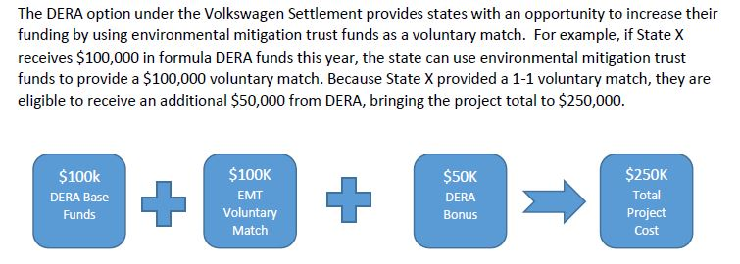
Environmental Mitigation Trust: Eligible Mitigation Actions
Diesel Emission Reduction Act (DERA) Option
may use Trust Funds for non-federal match or overmatch for DERA
allows beneficiaries to use Trust Funds for actions not specified in the settlement, but otherwise eligible under DERA (e.g. diesel emission mitigation retrofits)
Source: NASEO Volkswagen Beneficiary Mitigation Plan Toolkit

Slide 20
Environmental Mitigation Trust: Accessing and Spending Allocations
Beneficiaries have up to 10 years to spend 80% of their allocation, and up to 15 years to spend 100% of their allocation
Beneficiaries may request up to one-third of its allocation during the first year, and up to two-thirds of its allocation during the first two years
Beneficiaries can submit requests for Eligible Mitigation Action funding at any time (Appendix D, Sec. 5.2 for additional details)
Funding must be approved, approved with modification, or denied within 60 days
Beneficiaries may use its DERA proposal as its funding requests for Actions that are funded through the DERA option
Two or more beneficiaries may submit a joint request for Eligible Mitigation Action funds
Beneficiaries must submit a semiannual report
Occasional reapportionment of unused funds.

Slide 21
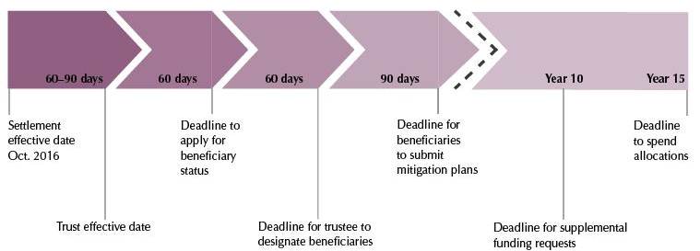
What Happens Next?
State assigns beneficiary agency
Takes in constituent feedback
State makes high-level policy decisions
What % does state keep for its fleet?
What % for local government? For private/commercial?
What policies will drive its funding decisions?
State releases detailed mitigation plan

Slide 22
Resources to assist policy decisions
Volkswagen Environmental Mitigation Trust: Recommendations for the State of Missouri (St. Louis and KC Regional Clean Cities)
www.metroenergy.org/index.php/volkswagen-settlement/
VOLKSWAGEN SETTLEMENT: BENEFICIARY MITIGATION PLAN TOOLKIT (NASEO: National Association of State Energy Officials)
www.naseo.org/volkswagen-settlement

Slide 23
Recommendations for the State of Missouri

Slide 24
Recommendations for the State of Missouri

Slide 25
NASEO Mitigation Plan Toolkit - Contents

Slide 26
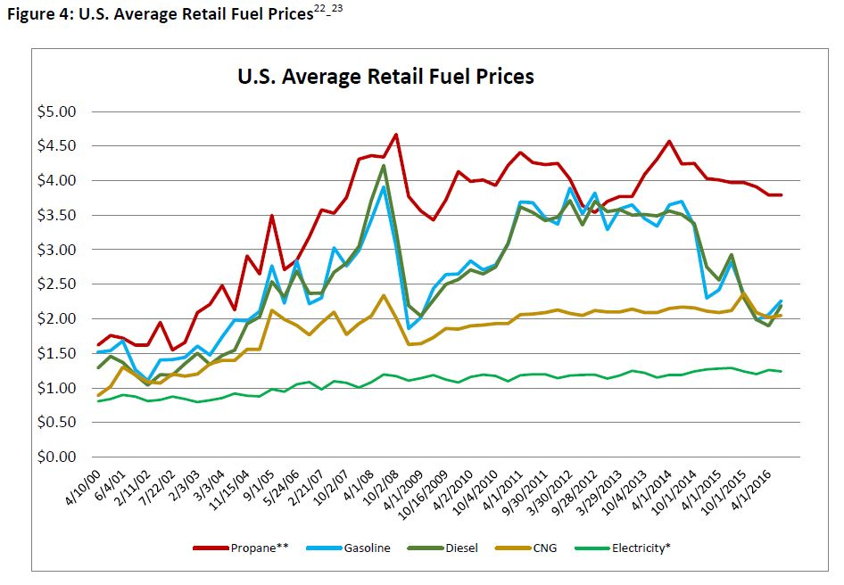
NASEO Mitigation Plan Toolkit

Slide 27
NASEO Mitigation Plan Toolkit

Slide 28
NASEO Mitigation Plan Toolkit

Slide 29
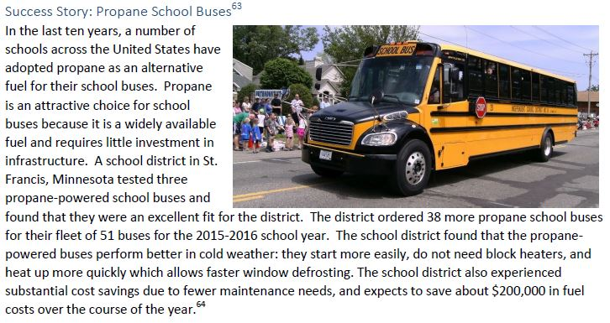
NASEO Mitigation Plan Toolkit

Slide 30
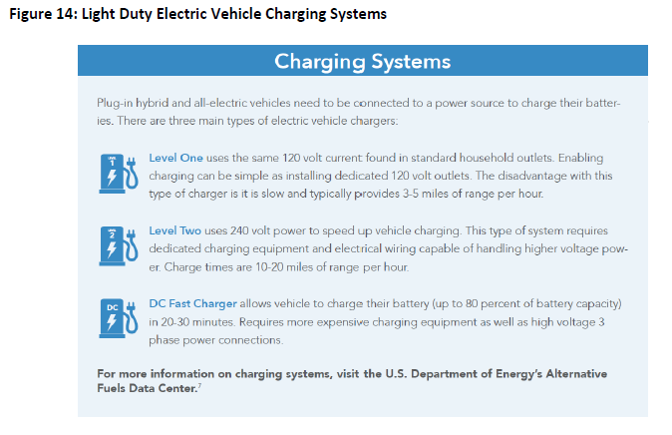
NASEO Mitigation Plan Toolkit

Slide 31
Environmental Mitigation Trust Summary
Every state has the opportunity to participate
Diesel vehicles, truck and bus Classes 4-8
Aging diesel vehicles, MY 1992-2009
(2010-2012 for states w mandates)
Destruction of replaced vehicles required
Various off-road and marine options
Electric Vehicle Supply Equipment
Missouri
$40 million

Slide 32
Thank you
How would you use VW (and other Clean Air Act) settlement funds?
http://tinyurl.com/z4r4a7l
Kevin Herdler, St. Louis: clnfuel@gmail.com
Kelly Gilbert, Kansas City: kelly@metroenergy.org
Special THANKS to our sponsor

